Slide 1
Local Anesthetics

Slide 2
THE LOCAL ANESTHETICS
drugs that suppress pain by blocking impulse conduction along axons
Conduction is blocked only in neurons located near the site of anesthetic administration.
pain can be suppressed without causing generalized depression of the entire nervous system
carry much less risk than that associated with general anesthetics
Mechanism of Action: stop axonal conduction by blocking sodium channels in the axonal membrane

Slide 3
Their method of administration is governed by such properties as
  toxicity, stability, duration of action water solubility, membrane permeability, and point of application
their modes of action depend on their lipid solubility, vasodilation, and protein-binding characteristics
used in dentistry, in ophthalmology, in minor surgical operations including endoscopy. and in relieving pain in intractable medical conditions. such as tumors growing in the spine
temporary relief of pain from insect bites, burns, and other types of surface wounds

Slide 4
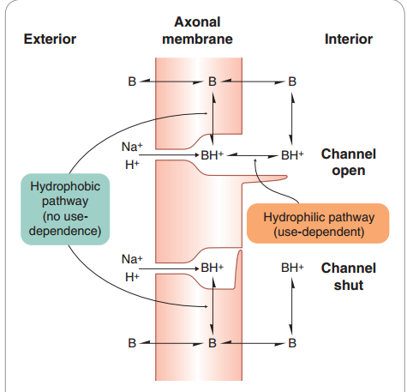
Interaction of local anaesthetics with sodium channels

Slide 5
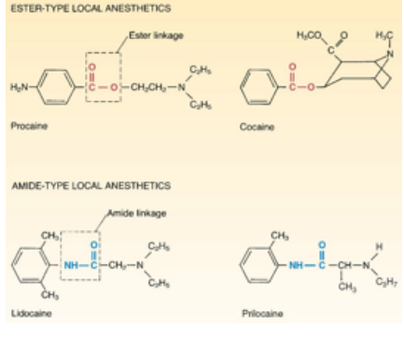
Classification
There are two major groups of local anesthetics: esters and amides
The general structure of local anaesthetic molecules consists of an aromatic group, ester or amide group and amine group

Slide 6
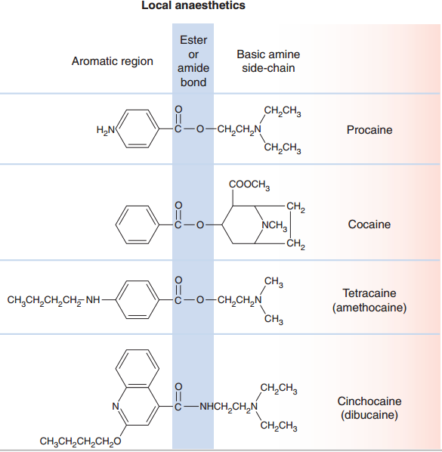
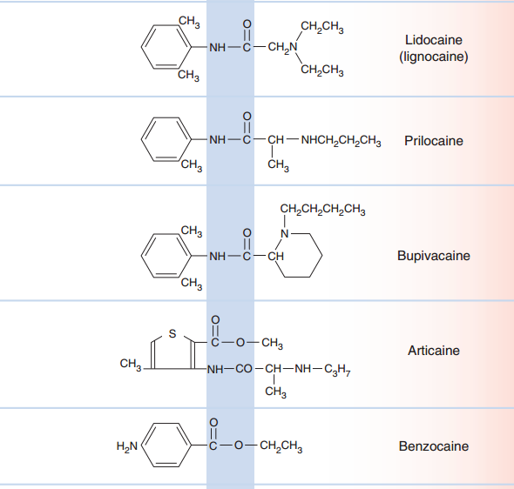

Slide 7
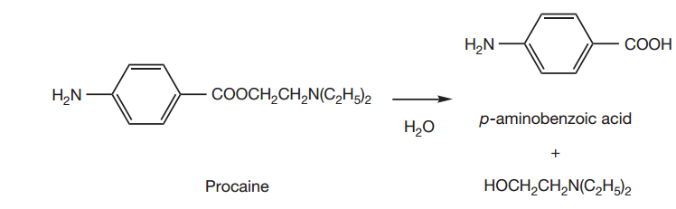
ESTER-TYPE LOCAL ANAESTHETICS
IN CURRENT USE
soluble in water in a 1:1 ratio and in alcohol 1:30
insufficiently lipophilic to be used in preparations for topical application to the skin
adrenaline at a concentration of 0.0005 % w/v is also included in the infusion

Slide 8
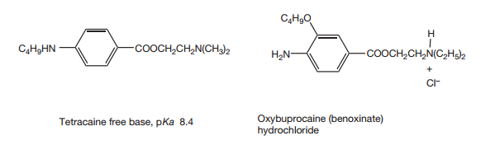
four times more slowly metabolized than procaine
fitting into the active site of the esterase
more stable to hydrolysis in aqueous solution than procaine, more lipophilic than procaine
lipophilic incorporated readily into creams or gels for topical application, insoluble in water,
gel 4% w/w, not apply to mucous membranes/inflamed tissues’
0.5% w/v or 1% w/v eye drops
HCl salt soluble in water, ethanol and chloroform
formulated in a 0.4% w/v eyedrop

Slide 9
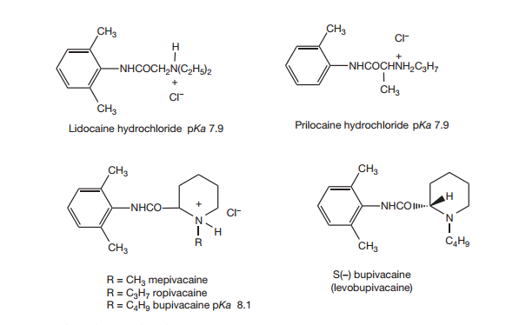
AMIDE-TYPE LOCAL ANAESTHETICS
wider safety margin which is probably because it has a lower partition coefficient
Lidocaine free base is virtually insoluble in water but is soluble in organic solvents
Lidocaine hydrochloride is freely soluble in water and ethanol but insoluble in organic solvents

Slide 10
much less distance than the corresponding distances in the ester-type Las
  base-weakening effect and the pKa values of all these drugs are around 8.0
  increases their partition coefficients into membranes at physiological pH in comparison with esters such as procaine, which has a pKa of 8.8.
less flexible due to restricted rotation about the CO–N bond due to it being involved in resonance stabilization
  Reduces the potency of the amide anaesthetics
the two methyl groups force the amide bond away from being in the same plane as the aromatic ring

Slide 11
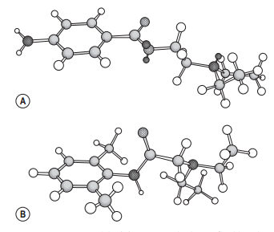
amide-based local anesthetic agents bind more readily to plasma(a1-acid glycoprotein) and tissue proteins than do ester-based agent in general more potent than the ester Las(55% to 95%)
their metabolic inactivation takes place in the liver
3-D models. (A) Procaine, displaying flexible side chain. (B) Lidocaine

Slide 12
Injections of lidocaine hydrochloride are available as 0.5%, 1% and 2% w/v
Creams typically contain lidocaine and prilocaine free bases both at 2.5% w/w

Slide 13
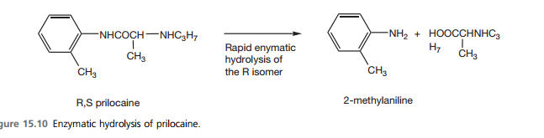
more readily enzymatically hydrolysed than that in lidocaine
only one of the enantiomers which are rapidly hydrolysed in the liver causing toxicity
2-methyl aniline hydrolysis product of metabolism can cause methaemoglobinaemia (lidocaine, prilocaine, and benzocaine)
oxidation of iron (II) in haemoglobin to iron (III)

Slide 14
10 to 20 g/L (6%–12% of the normal hemoglobin concentration)
Cyanosis results and does not respond to treatment with 100% oxygen.
increased risk factors for methemoglobinemia include
  children younger than 2 years,
  anemic patients,
  genetic deficiency of glucose-6-phosphate dehydrogenase or nicotinamide adenine dinucleotide methemoglobin reductase or
  exposed to excessive doses of the causative local anesthetic.

Slide 15
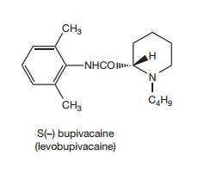
Slow onset of action(less flexible)
Longer DOA(more lipophilic-resides longer in nerve membrane)
Most frequently used for spinal anesthesis (surgery, childbirth)
Mixtures of two enantiomers(equipotent)
S(-) more selective for sensory neurons
Less risk of motor neuron block, associated with cardiotoxicity)
vasoconstrictor

Slide 16
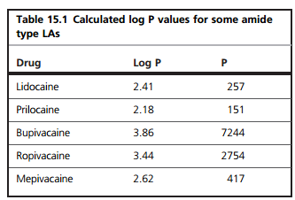
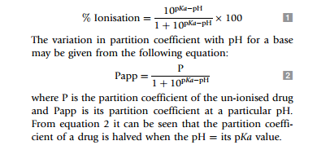

Slide 17
RATE OF ONSET AND DURATION OF
ANESTHESIA
The time for the onset of action appears to be related to
  the type of tissue being anesthetized
  the method of administmtion
  the percentage of the local anesthetic agent in its unprotonatcd form at physiological pH.

Slide 18
local anesthetic agents with a low value Pka and high lipid solubility usually have a more rapid onset of action than those with higher pK values and lower lipid solubility
  For example lignocaine, which is about 35% unprotonated at pH 7.4, usually has a more rapid onset of action than bupivacaine Which is about 8% unprotonated at this pH
The time taken for drug to diffuse from its site of application to its site of action will also affect the rate of onset of anesthesia

Slide 19
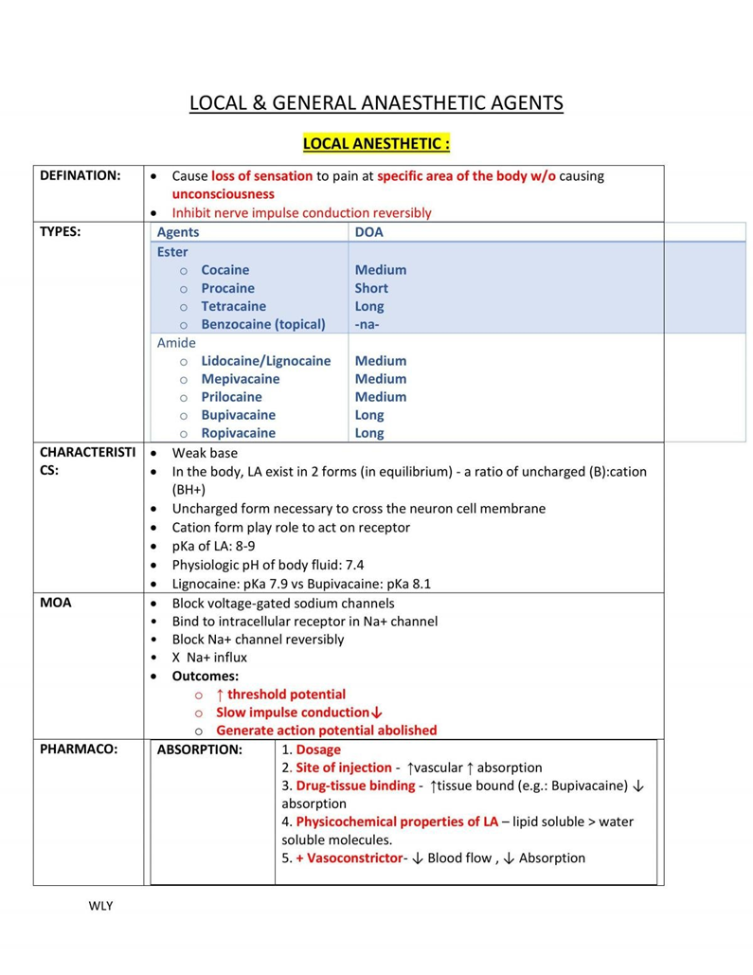
Anilides
amide derivatives of aniline

Slide 20
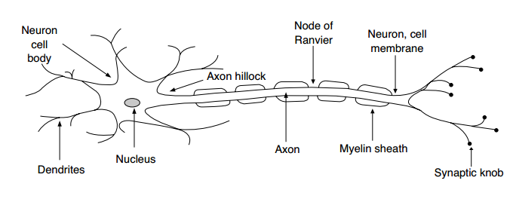
inhibit the conduction of action potentials in all afferent and efferent nerve fibers
Nerve impulses travel at speeds of up to 120 m/s in myelinated axons and 10 m/s in unmyelinated axons

Slide 21
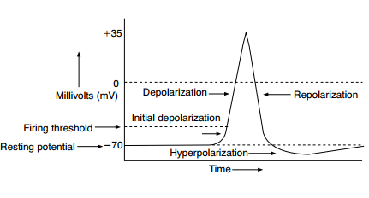
Changes in electrical potential observed during a nerve impulse

Slide 22
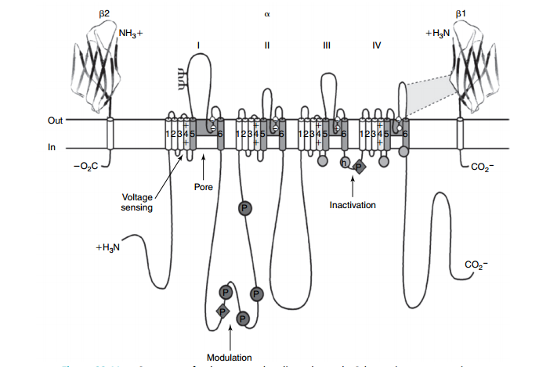
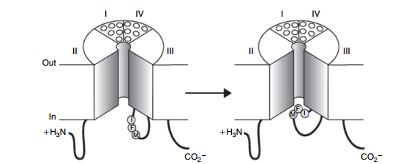
Structure of voltage-gated sodium channels

Slide 23
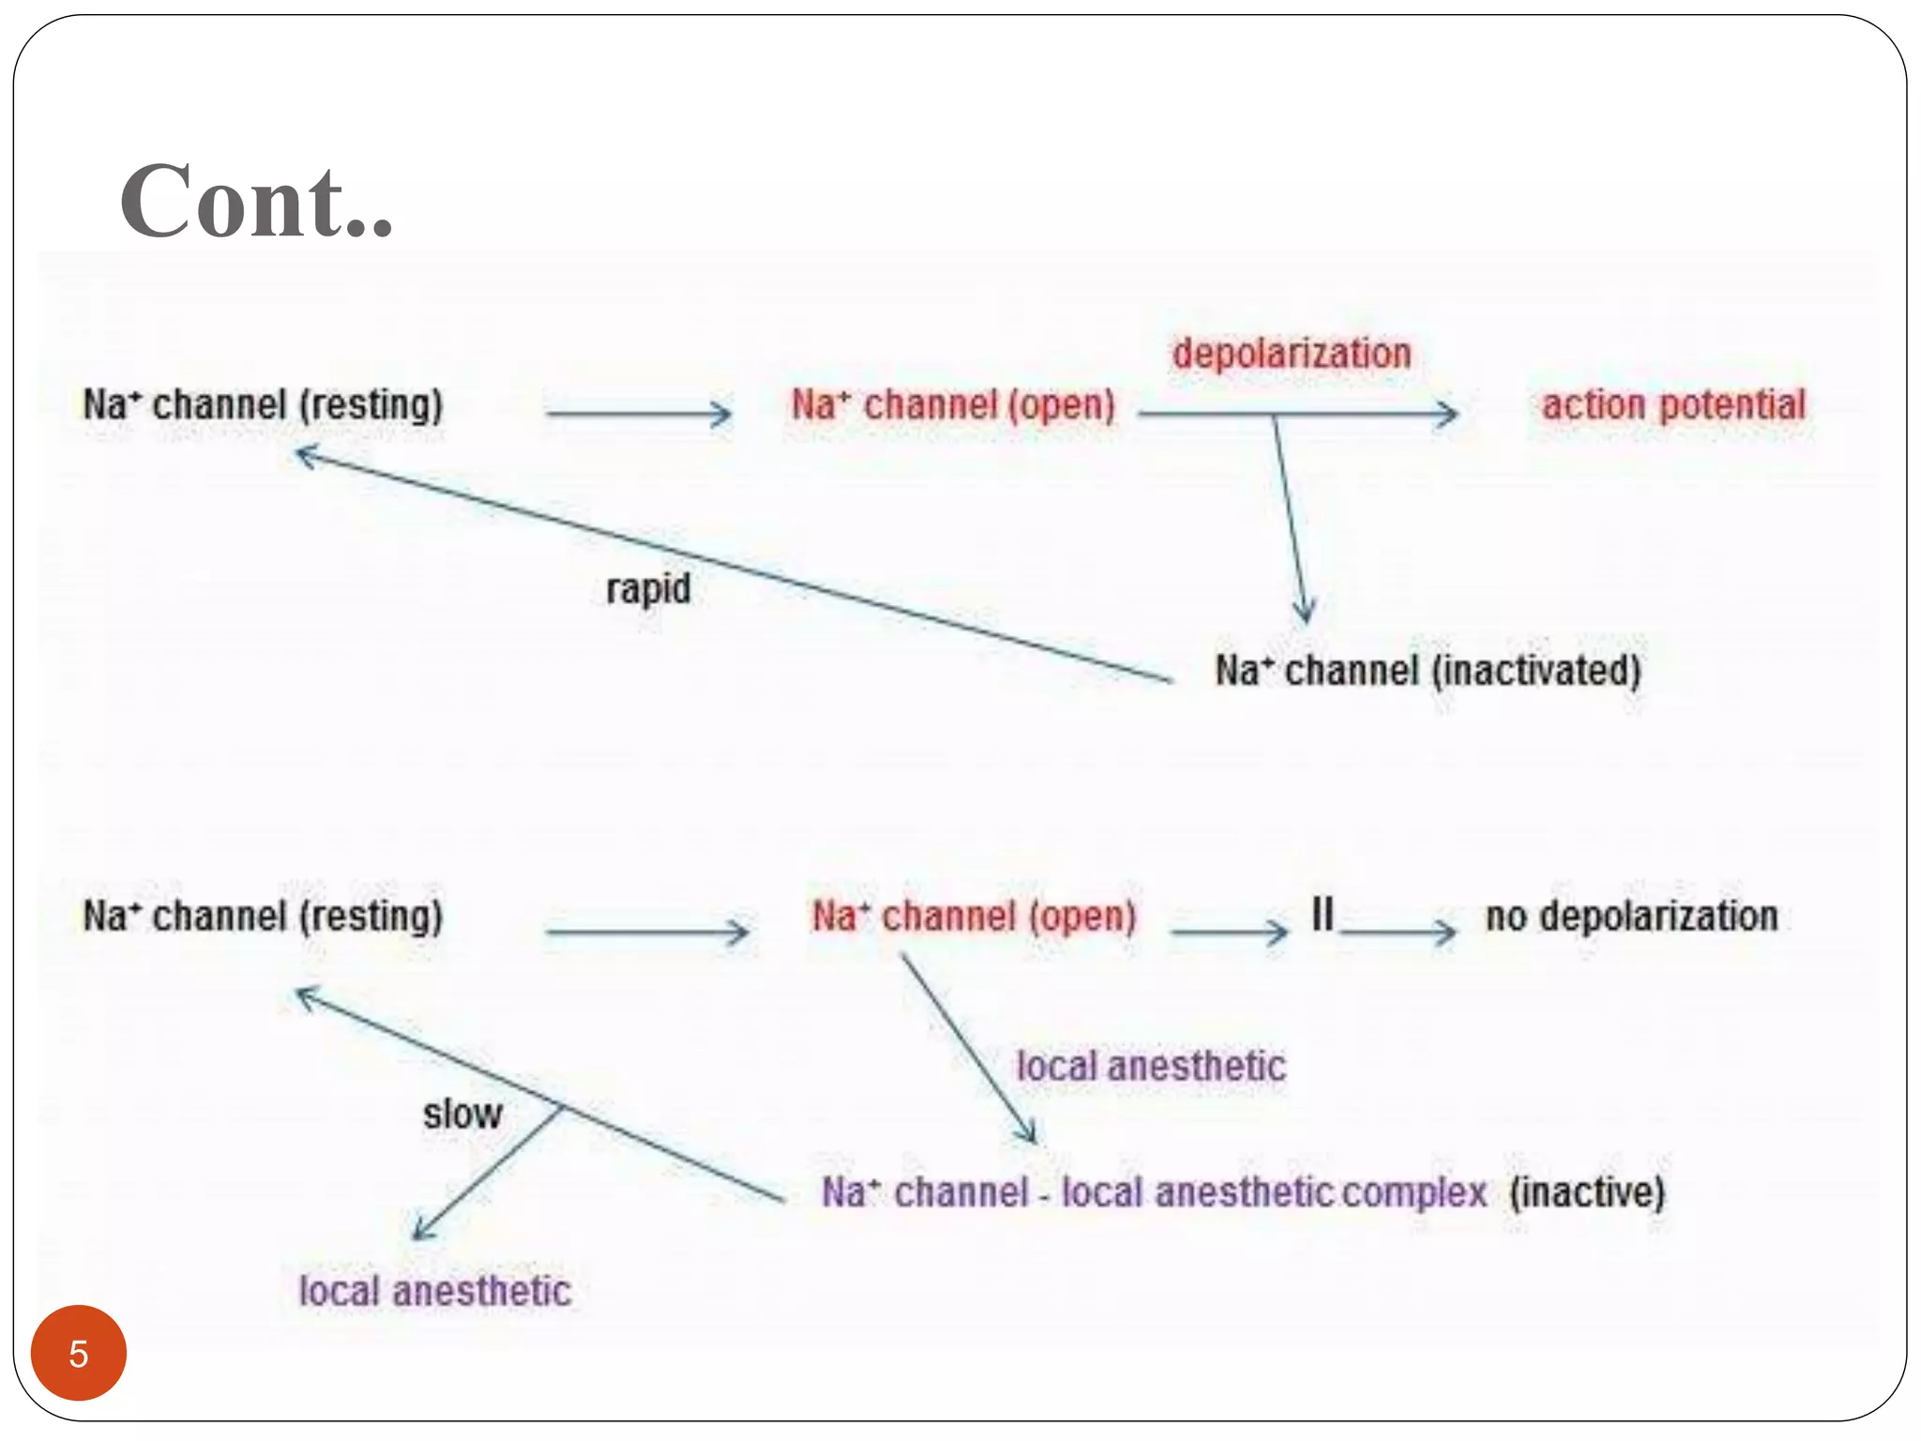

Slide 24
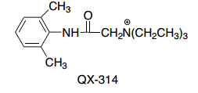
local anesthetics containing a tertiary nitrogen also confirm that the local anesthetic is accessing the binding site from either the hydrophobic or hydrophilic pathways
When this type of anesthetic is applied externally, and the pH of the external media is increased, and thus the local anesthetic is predominantly in the unionized form, the onset of block is more rapid

Slide 25
In general, at resting states, when the membrane is hyperpolarized, the local anesthetics bind with low affinity.
When the membrane has been depolarized and the channel is open, local anesthetics bind with high affinity.
Local anesthetics also bind with high affinities when the sodium channel is in the “closed/inactive” conformation, perhaps stabilizing the inactive form of the receptor

Slide 26

SARs of Local Anesthetics
lipophilic ring that may be substituted
a linker of various lengths contains either an ester or an amide
an amine group usually a tertiary amine with a pKa between 7.5 and 9.0.
Aromatic ring:
adds lipophilicity to the
direct contact with the local anesthetic binding site
¶–¶ interaction or a ¶-cation interaction

Slide 27
Substituents:
  increase the lipophilic nature of the aromatic ring
  para substituted ester type local anesthetics showed that lipophilic substituents and
  electron-donating substituents in the para position increased anesthetic activity
increase lipophilicity and their affinity at the receptor site

Slide 28
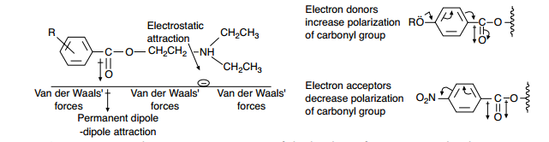
Schematic representation of the binding of an ester-type local anesthetic agent to a receptor site

Slide 29
Linker:
  Increase in number of carbon atoms the lipid solubility, protein binding, duration of action, and toxicity increases
  Esters and amides are bioisosteres having similar sizes, shapes, and electronic structures
    usually differ only in their stability in vivo and in vitro
  amides are more stable than esters and thus have longer half-lives than esters(protein binding more prevalent for the amide anesthetic)

Slide 30
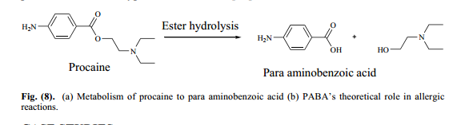
the binding affinity and stability of the anesthetic molecule is affected by the linker, the functional groups on the aromatic ring
allergic reactions(PABA metabolite of ester class)

Slide 31

The Nitrogen:
  Most local anesthetics contain a tertiary nitrogen with a pK_{a} between 7.5 and 9.5
  Therefore, at physiological pH, both the cationic and neutral form of the molecule exists

Slide 32
Vasoconstrictors Used in Combination with Local Anesthetics:
  Many anesthetic preparations are commercially available combined with the vasoconstrictor epinephrine(longer duration of action, lower systemic adsorption)

Slide 33
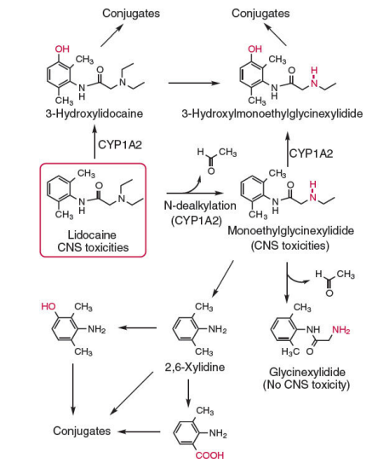
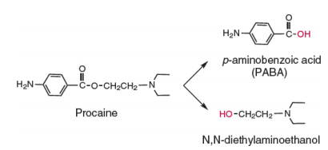
Metabolism of procaine and lidocaine

Slide 34
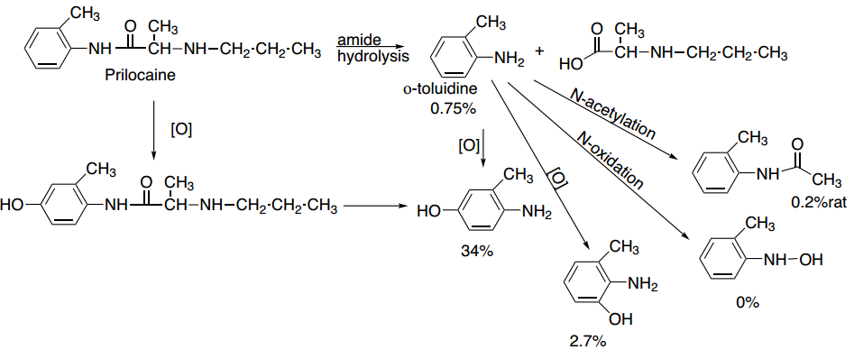
Many aromatic amines, including o-toluidine
have been shown to be mutagenic, form DNA adducts, methemoglobinemia
Metabolism of prilocaine

Slide 35
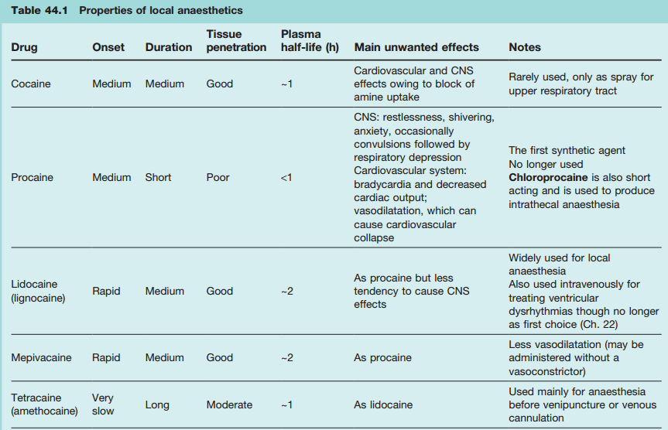

Slide 36
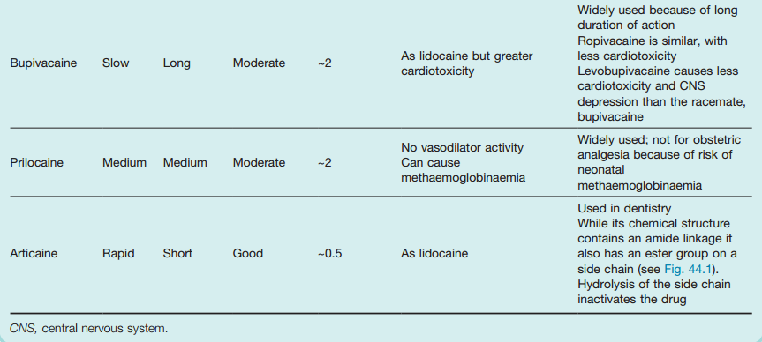

Slide 37
ADMINISTRATION
Topical or Surface Anesthesia
  Direct application of a local anesthetic agent to the skin or a mucous membrane
  applied in the form of a liquid, spray, cream, ointment, or gel
  mucous membranes of the ear, nose, and throat: aqueous solutions of the salts of tetracaine, lignocaine or cocaine
Infiltraion: in a suitable solvent system injected directly into the area of the body that is to be anesthetized

Slide 38
The most frequently used local anesthetics for infiltraion are lignocaine Bupivacaine and procaine
require large concentrations of anesthetic to bring about the desired degree of anesthesia
Field Block Anesthesia: injected subcutaneously at a point adjacent to the area that is to be anesthetized
Produces a larger region of anesthesia with a lower dose of the local anesthetic than it is required by the infiltration technique.

Slide 39
Regional Nerve Block Anesthesia
  either injection of the anesthetic in a suitable solvent system into the nerve or infiltration of the anesthetic into the tissue surrounding a nerve or plexus supplying the region to be anesthetized
  spinal anesthesia may be brought about by injection into the cerebrospinal fluid in the subarachnoid space.
  Dental anesthesia is brought about by flooding the area around the nerve by injecting the anesthetic into the adjacent tissue

Slide 40
intravenous Reglonai Anesthesia
to anesthetize a large region, such as a limb
its blood flow restricted by a tourniquet
Lignocaine is frequently used to produce intravenous regional anesthesia,
but hupivacaine is not approved for this purpose because of its long duration of action.

Slide 41
Spinal Anesthesia: injecting the anesthetic agent into the subarachnoid space in the spinal cord
Epidural Anesthesia:
  injected into the epidural space between the vertebrae and spinal cord.
  This numbs the nerves leading to the uterus and the pelvic area and leads to pain relief during labor.
  Epidural anesthesia may sometimes cause headaches.

